Slide 1
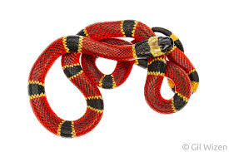
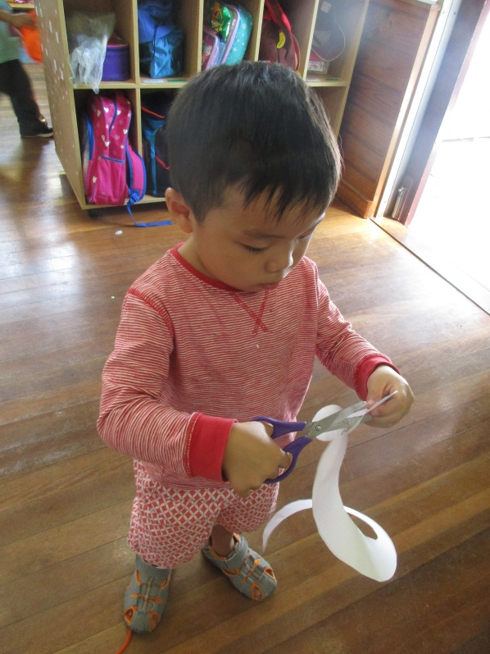
Toby’s Stinky Snake
Toby, as I walked over to the craft table to see how everyone was going with their cutting, I noticed lots of bits and pieces of the snake stencil tragically cut off by our children obviously still struggling to master their cutting skills. When I looked over at you, surprisingly not only did you have your snake in one piece, you were also using your scissors correctly, placing your thumb up and cutting away from your body. You sat down and proceeded to colour your snake in. 20 minutes later I looked to see you still at the table. Curious as to why you haven’t moved from the craft table, I came over to see what had you so engaged. You showed me your beautiful red and black snake which you obviously took so much care and time to complete. Wanting to know why you were so fascinated with this snake, I began to ask you about it and that’s when I realised this was more than just a stencil for you, this snake became a creative character in your head. You told me that its blood stinks and that it bites people. This snake has poison and when it bites people, they will turn into a snake too. If you burn this snake it will turn black in colour. Knowing how keen your mother is at wanting to improve your writing, I suggested we go over to the writing table to write down your snake’s name. Your keen interest in your snake became my hook to getting you to practise your writing and you did an amazing job, giving your snake the name stinky. I wrote the name and you carefully tried to copy my letters. At times I had to remind you to put your letters closer together and you struggled with the letter k but that’s okay, the letter K is quite difficult to write. When it came to writing the letter y, you realised your y was different to mine and you justified that by saying that “I’m making a different y it’s a different type of y” I had to smile at your quick thinking skills and wondered if you often have to justify yourself when you find yourself in trouble at home. You must have been really proud of your efforts as you took your snake and had it by your side until the end of the day.

Slide 2
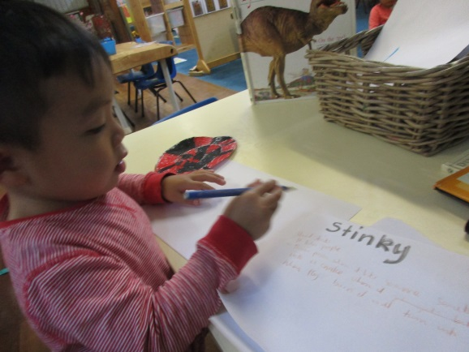
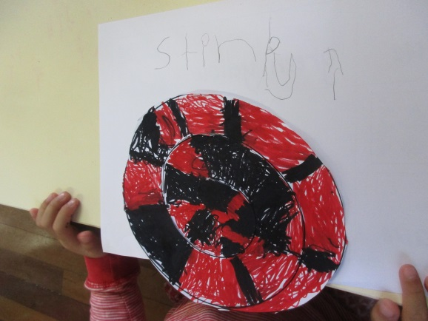
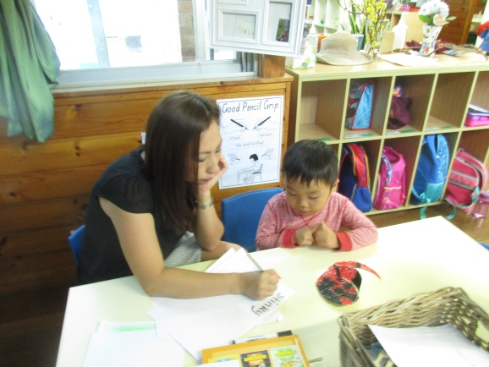
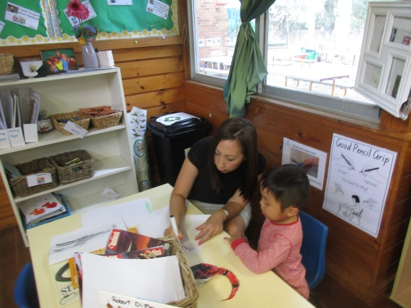
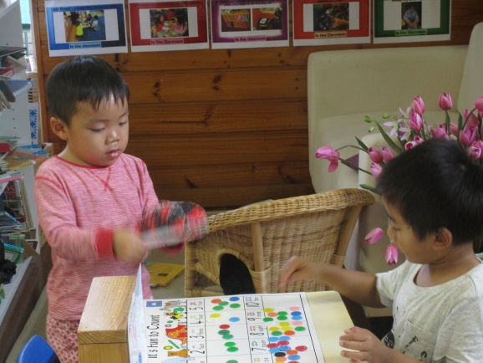
Toby’s Stinky Snake
Analysis of the learning-
Toby, today I got to know you better, I think you are an amazingly persistent and creative member of our class. Your imagination and creative abilities are phenomenal and know that this is a skill not everyone has. I hope you never lose your creative thinking and ideas as one day it will help you become a creative writer with an imagination that knows no bounds. Today you showed me what a focused learner you are, and you had a go at writing even though there were letters you couldn’t really write yet, you didn’t ask for help or give up, you simply had a go and that is what truly impressed me today- Your ability to take a risk and not be afraid of making mistakes. This is something I struggle to do as an adult so I am so impressed that you’re a risk taker and I hope you continue to be a risk taker throughout your school years.
Written by Ms Lien Chai 2/3/2017

